Slide 1
Openshift

Slide 2
Openshift Intro

Slide 3
An Introduction to Openshift

Slide 4

What is Openshift?
Notes:
Instructor notes: Images obtained from Pixabay at these links. https://pixabay.com/en/keyboard-shift-leave-computer-1621104/ https://pixabay.com/en/door-open-wall-open-door-home-1756960/

Slide 5

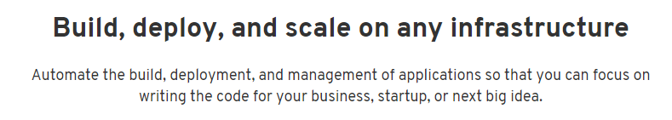
What is Openshift?
Openshift is an open-source container platform solution offered by Red Hat®, which allows developers to quickly to develop, maintain, and deploy containers on a server.
Openshift uses both Kubernetes and Docker to function as a standalone container platform solution.
Openshift is a type of cloud service classified as Platform as a Service (PaaS).
The Openshift website describes their own service in this way:
Notes:
Instructor notes: Openshift logo obtained from this link. https://cdn2.hubspot.net/hubfs/4305976/images/openshift-legacy/logos/openshift/Logotype_RH_OpenShift_wLogo_RGB_Black.png?t=1527889942328 Openshift quote obtained from this link. https://www.openshift.com/products

Slide 6
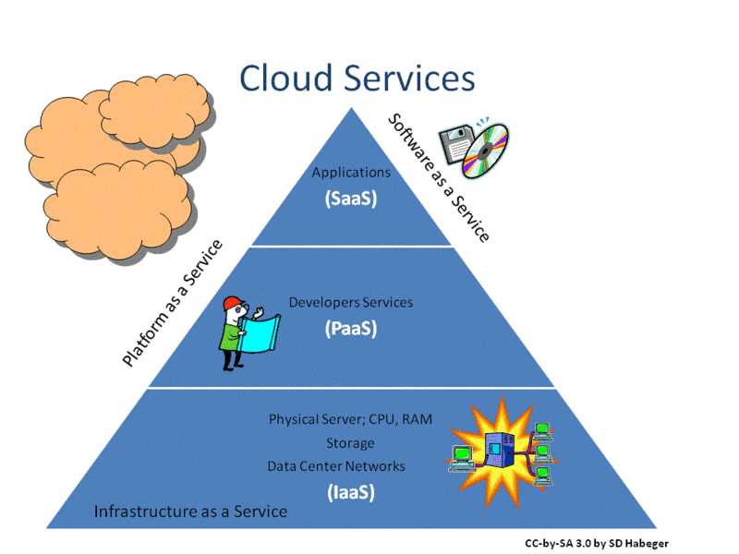
Types of Cloud Services:
Infrastructure as a Service (IaaS)
Platform as a Service (Paas)
Software as a Service (SaaS).
Notes:
Instructor notes: Please review the participant notes. Image by author Sdhabeger (2010). Obtained from this link. https://commons.wikimedia.org/wiki/File:Cloud_Services.gif Participant notes: Cloud vendors generally offer different options of their services and most of the Cloud vendors will give you different options of services which may include Iaas, Paas, Saas.

Slide 7
Infrastructure as a Service (IaaS)
IaaS is a type of cloud service which provides:
Servers and server related hardware
Virtualization
Storage
Networking.
If you utilize an IaaS service you will need to provide the:
Applications
Data
Runtime
Middleware
Operating system.
Examples of IaaS service include:
Amazon Elastic Compute Cloud (EC2), Microsoft Azure VM, Google Compute Engine (GCE).
Notes:
Instructor notes:

Slide 8
Platform as a Service (Paas)
PaaS is a type of cloud service which provides:
Runtime
Middleware
Operating system
Server and Server related hardware
Virtualization
Storage
Networking.
If you utilize a PaaS service you will need to provide the:
Applications
Data.
Examples of PaaS include:
Openshift, Heroku, Amazon Elastic Beanstalk, Google App Engine.
Notes:
Instructor notes: Openshift is a relevant example of PaaS.

Slide 9
Software as a Service (SaaS)
SaaS is a type of cloud service which provides:
Application
Data
Runtime
Middleware
Operating System
Server and Server related hardware
Virtualization
Storage
Networking.
This includes software which is available on a subscription basis and is centrally hosted.
Examples of SaaS includes:
Salesforce.com, Microsoft Office 365 cloud, Google Apps.
Notes:
Instructor notes:

Slide 10

What is a Container?
A container image is a lightweight executable software package which contains:
the software code
runtime
system libraries
settings.
It is comparable to a lighter version of a virtual machine.
Running applications using containers helps the application be compatible on different types of systems.
Notes:
Instructor notes: Information about container obtained from Docker website at this link. https://www.docker.com/what-container

Slide 11
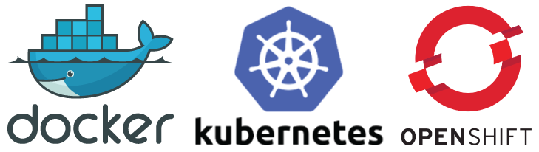
Docker, Kubernetes, and Openshift
Docker, Kubernetes, and Openshift work together to get your apps up and running.
Openshift is an all-in-one solution that uses Docker and Kubernetes to deploy functioning applications on the cloud or on your on-premises server.
Notes:
Instructor notes: Logos obtained from this link. http://www.aemk.org/wp-content/uploads/2017/10/techlogos.png

Slide 12

What is Docker and How is It Different Than Openshift?
Docker is a software solution which provides the framework and capability to convert existing applications and infrastructure into individualized containers to enable them to be compatible on any type of system.
Openshift uses Docker-based container applications as a part of its container platform solution, but Openshift also:
provides a system for the containers to operate
deploys the containers into functioning applications on the cloud or on on-premises infrastructure.
Openshift also allows you to submit the source code of an application and it uses Docker to create a container for you.
You can also deploy applications which are already in container image files.
Notes:
Instructor notes: Docker logo obtained from this link. https://www.docker.com/sites/default/files/horizontal.png

Slide 13
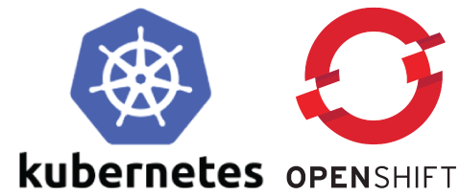
What is Kubernetes and How is It Different Than Openshift?
Kubernetes is an open-source container orchestration system which allows the applications and containers to communicate and function in a single unit.
Openshift uses Kubernetes as a part of the container platform, but Openshift also provides a solution to deploy and manage the Kubernetes nodes on the server.
Notes:
Instructor notes: Logos obtained from this link. http://www.aemk.org/wp-content/uploads/2017/10/techlogos.png

Slide 14
Openshift Services
Openshift offers three types of services:
Openshift Online
Openshift Dedicated
Openshift Container Platform.
Notes:
Instructor notes: Please review the participant notes. Participant notes: Learn more at this link. https://www.openshift.com/products

Slide 15
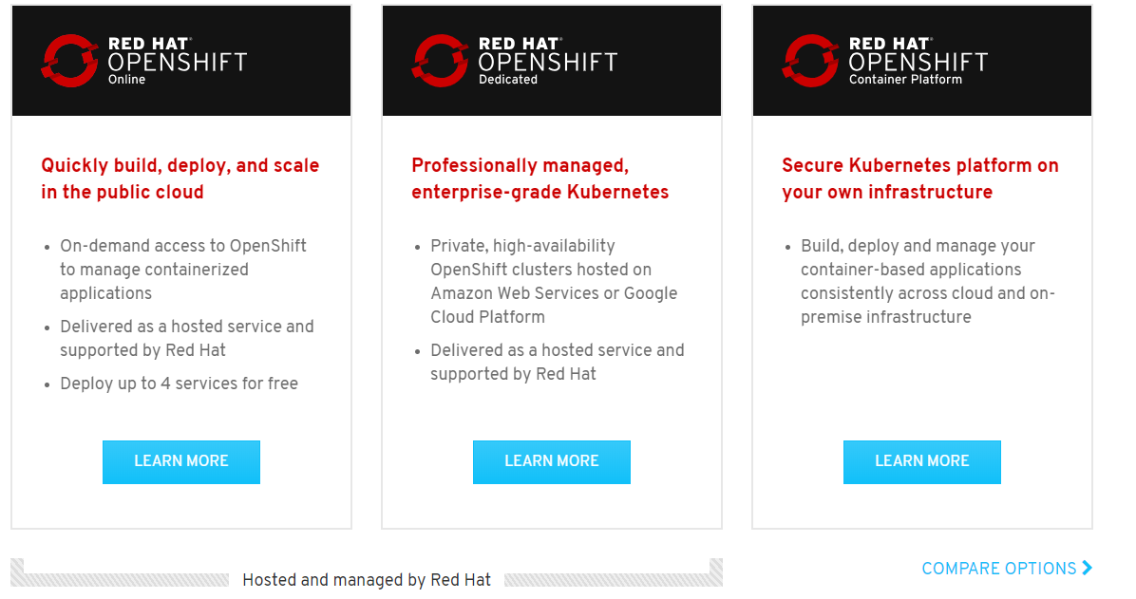
Types of Services Which Openshift offers:
Notes:
Instructor notes: More information on the services on the next page. Openshift services image obtained from this link. https://www.openshift.com/products

Slide 16
Openshift Online
Openshift Online:
A web-based service which allows developers to use Openshift as a container platform solution on the Red Hat® public server. There are two plans:
Starter plan - A free version for testing purposes where you can deploy 1 project on their public cloud.
Pro – A limited professional plan where you can run 10 projects on their public cloud for $50.00 / month.
Notes:
Instructor notes: Please review the participant notes. Participant notes: You may contact Red Hat® directly for more information at this link. https://www.openshift.com/about/contact

Slide 17
Prerequisites to Running Openshift Online and Openshift Dedicated
It doesn't take much to get applications running with Openshift Online or Openshift Dedicated. Here are a few things you would need:
A Github account
Computer system with internet connectivity
OS: Windows / Linux / MAC
Source code of the applications to run or applications in a Docker container file image format
The source code or container file images need to be in an accessible location such as a Github repository
Git software installed on the local computer.
Notes:
Instructor notes: There will also be separate developer requirements for the development of your applications. For the lab exercises for Openshift, participants will only need a Github account and computer system with internet activity to start the exercise. Participants will need a text editor other than notepad installed to their system starting with Openshift Lab 2.2.

Slide 18
Openshift Dedicated
Openshift dedicated:
An enterprise solution which provides large scale private clusters for use with Openshift services on Amazon Web Services (AMS) or Google Cloud Platform (GCP).
Pricing starts at $48,000/year.
Please contact Openshift sales directly for customized pricing.
The private clusters with AMS or GCP are included.
Supports connectivity with your internal network.
No specific hardware requirements specified since it is cloud based.
Notes:
Instructor notes: Please review the participant notes. Participant notes: Learn more at this link. https://www.openshift.com/products

Slide 19
Openshift Container Platform
Openshift Container Platform:
A solution to use Openshift to "build, deploy and scale" your application framework in both on-premises infrastructure as well as on the cloud.
Works by creating an integrated container registry called OpenShift Container Registry (OCR) to operate on the cloud or on on-premises hosting systems.
Notes:
Instructor notes: Please review the participant notes. Quote obtained from this link._ https://www.openshift.com/products Participant notes: You may contact Red Hat® directly for more information at this link. https://www.openshift.com/about/contact

Slide 20
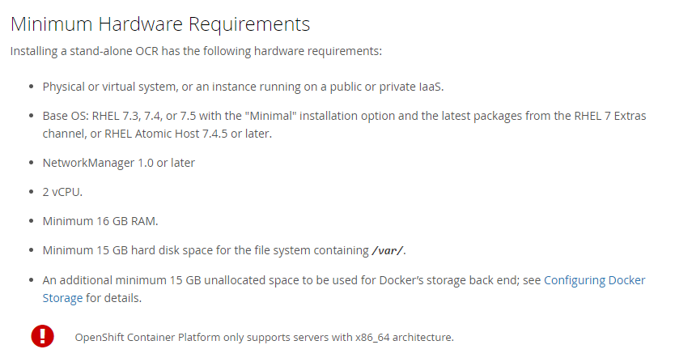
Host Requirements for Openshift Container Platform
An Openshift Container Registry is abbreviated OCR.
It can be installed on the cloud or as a standalone service.
The host requirements of the standalone OCR are described below.
Notes:
Instructor notes: These host requirements are not applicable if you are not hosting the server. Information and image obtained from this link. https://docs.openshift.com/container-platform/3.9/install_config/install/stand_alone_registry.html

Slide 21
Openshift Features

Slide 22
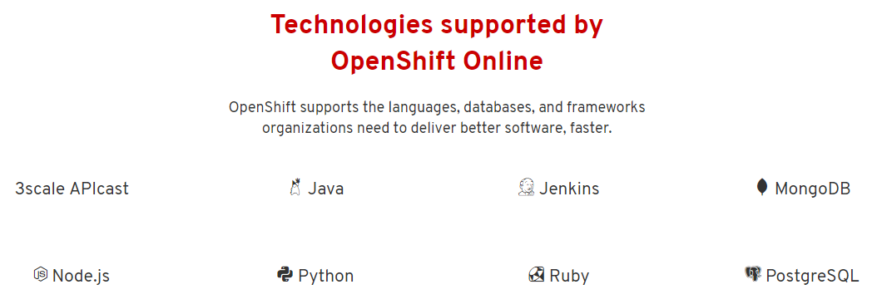
Support for Many Types of Technologies & Languages
Supports many types of container files, programming languages, databases, and other technologies, including the following and more:
Notes:
Instructor notes: Please review participant notes. More detailed information on the next page. Technologies supported screenshot obtained from this link. https://www.openshift.com/products/online/ Participant notes: See complete list of languages supported at this link. https://www.openshift.com/products/features/containers/#online3

Slide 23
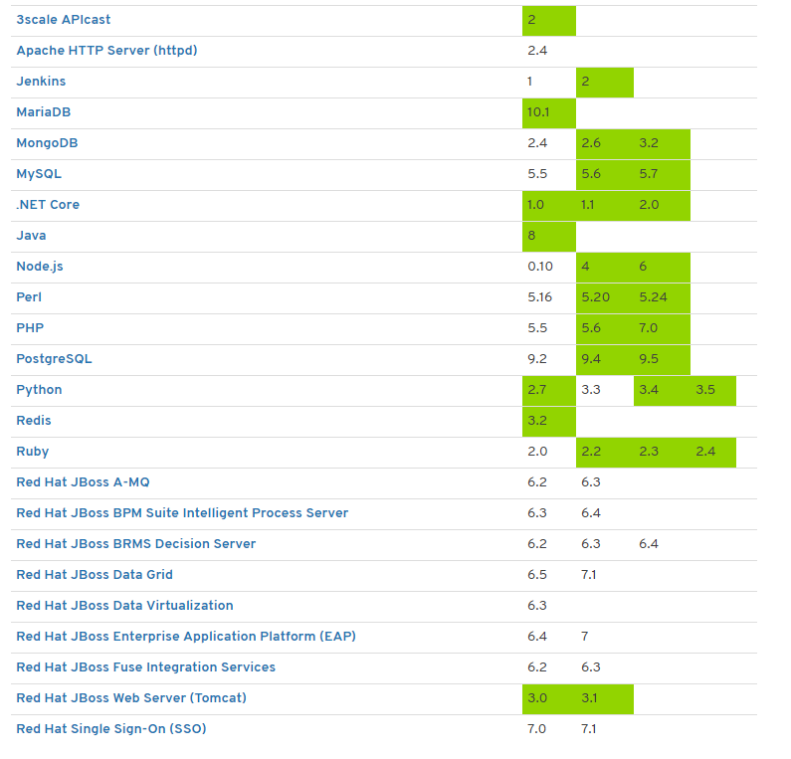
View of Technologies Supported by Openshift Online
Notes:
Instructor notes: Please review the participant notes. Screenshot obtained from this link. https://www.openshift.com/products/features/containers/#online3 Participant notes: Technologies supported by Openshift Dedicated at this link. https://www.openshift.com/products/features/containers/#dedicated Technologies supported by Openshift Container Platform at this link. https://www.openshift.com/products/features/containers/

Slide 24
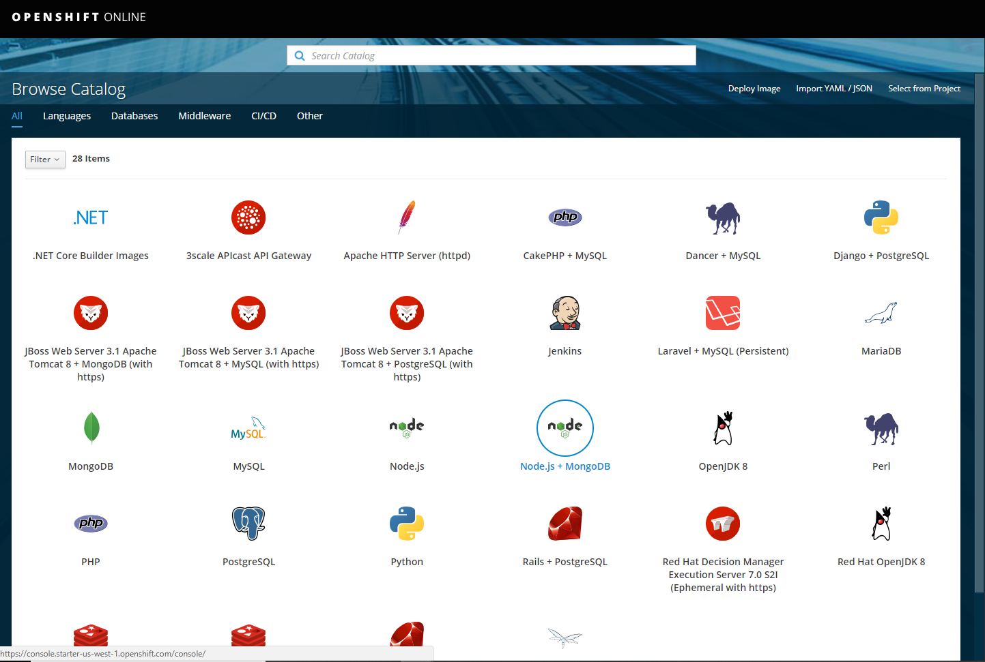
Many Different Tools and Templates Available
Openshift allows you to "deploy your favorite application runtimes, frameworks, databases, and more in one click." This is a view of the Openshift web console.
Notes:
Instructor notes: Quote obtained from this link. https://www.openshift.com/products/online/ Image obtained from web console at this link. https://console.starter-us-west-1.openshift.com/console/catalog

Slide 25
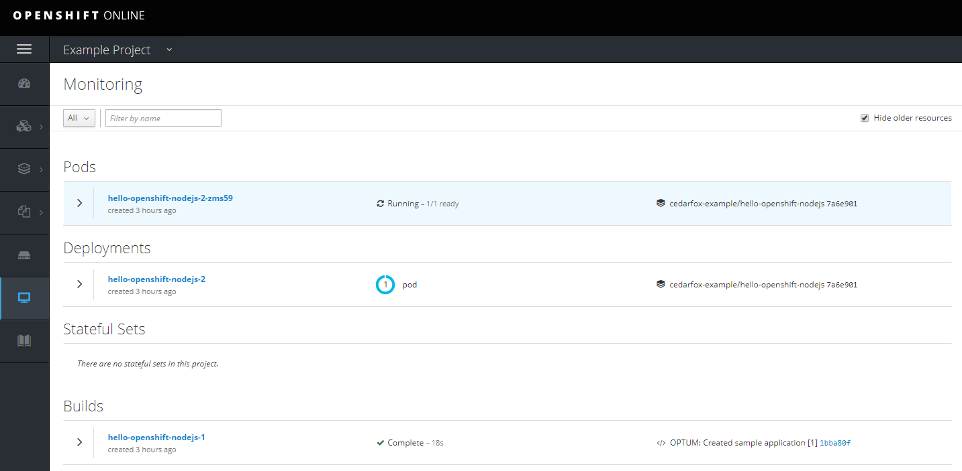
Web Console for Openshift Online
An interactive web console to easily deploy and manage applications.
Notes:
Instructor notes: During the Openshift Labs, participants will have the opportunity to explore the web console with a free starter plan. Screenshot obtained from a view of user web console under project. https://console.starter-us-west-1.openshift.com/console/catalog

Slide 26
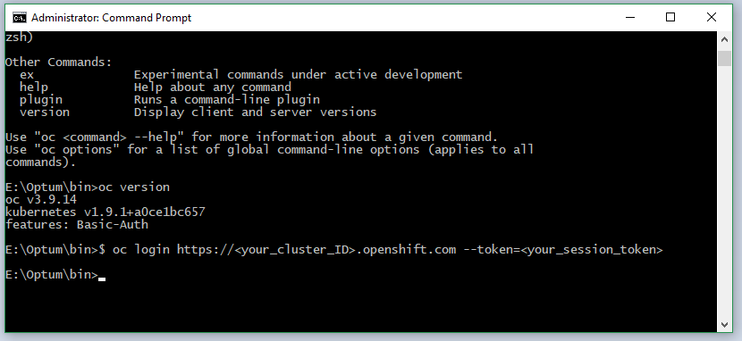
Command Line Interface for OpenShift
A command line interface allows for more powerful management of your apps.
Notes:
Instructor notes: A helpful tutorial for installing Openshift tools is found at this link. https://blog.openshift.com/installing-oc-tools-windows/

Slide 27
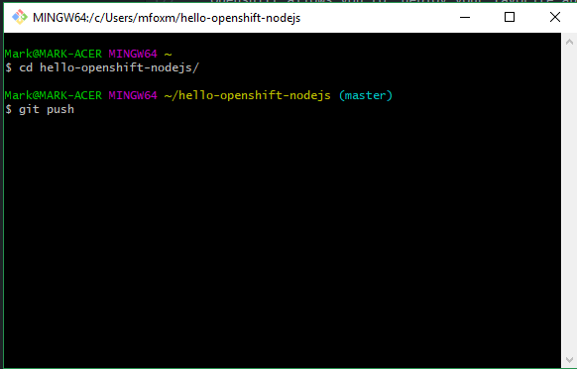
Easily Update Your Changes Using a "git push" Command
Openshift allows you the ability to automatically rebuild the applications whenever you push your updates to the repository.
Notes:
Instructor notes: The lab exercises show how to install and use basic git commands.

Slide 28
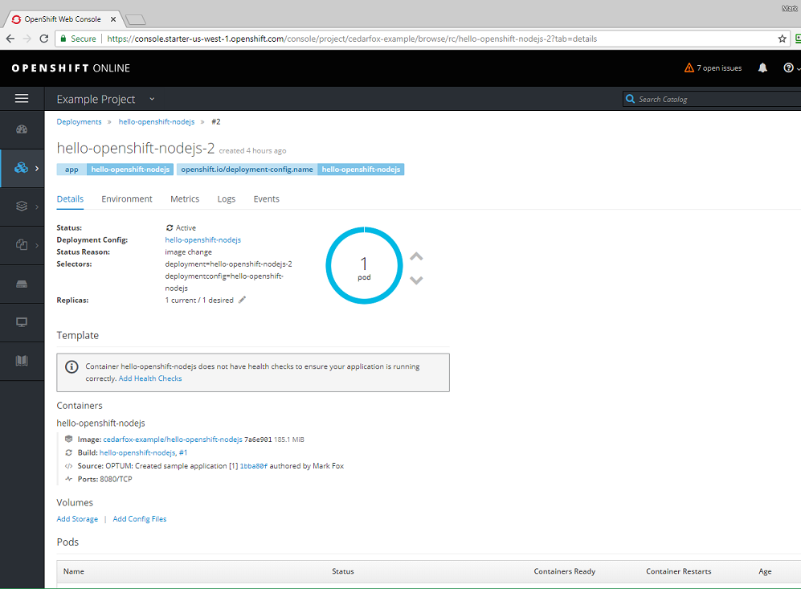
Tools available to easily deploy, monitor, and manage applications
Notes:
Instructor notes: Screenshot obtained from a view of user web console under project. https://console.starter-us-west-1.openshift.com/console/catalog

Slide 29

Openshift Reviews
Matt D'Angelo at Business.com (5/23/2018) "Best Cloud Computing Services."
"OpenShift by Red Hat® is a platform as a service (PaaS) designed for developers. Many typical systems administration tasks, like virtual server provisioning, configuration and scaling, are automated so developers can spend more time on code and less time configuring operating systems and installing libraries and packages.
Notes:
Instructor notes: PaaS means "Platform as a Service" -- a type of cloud computing services. https://en.wikipedia.org/wiki/Platform_as_a_service Matt D' Angelo Business.com obtained from this link. https://www.business.com/reviews/openshift/

Slide 30
Openshift Reviews
Aivann Carlo Cariaga with Upwark (5/3/2018) "Great for solo and large Enterprises."
"OpenShift is a great way to start, especially their free tier. It is excellent for software engineers who want to learn PaaS. I have tested many PaaS system from Heroku, IBM Bluemix, to Azure Microsoft. It is great for solo developers and large enterprises."
Notes:
Instructor notes: PaaS means "Platform as a Service" -- a type of cloud computing services. https://en.wikipedia.org/wiki/Platform_as_a_service Aivann Carlo Cariaga review obtained from this link. https://www.trustradius.com/products/openshift/reviews

Slide 31
Openshift Architecture

Slide 32
What Services Does Openshift Container Platform Provide?
Docker - packages the lightweight container images.
Kubernetes - orchestrates the containers and helps to manage the clusters.
Openshift Container Platform adds the following:
Management of:
Source code
Builds
Deployment of applications
Images - container files
Scaling of the applications
User tracking
Network infrastructure.
Notes:
Instructor notes: Please review the participant notes. Builds are a compiled or executable programs. See this link on builds. https://docs.openshift.com/container-platform/3.9/architecture/core_concepts/builds_and_image_streams.html#builds Information about Openshift architecture obtained from this link. https://docs.openshift.com/container-platform/3.9/architecture/index.html Participant notes: Scaling of the applications means deploying and managing of an increasing number of instances of the application.

Slide 33
Infrastructure Components of Openshift Container Platform
Containers and images
Pods
Services
Nodes
Replication Controllers
Routes
User
Notes:
Instructor notes: Please review the participant notes. Participant notes: Infrastructure components: Containers and images - such as Docker container images. Pods a Kubernetes subunit One or more container in a functioning virtual unit - this allows the containers to communicate with each other. Services - define sets of pods and policies of when/how to access them. Node - a single server unit consisting of pods and services. Replication Controllers - monitor multiple instances of replicas of pods to make sure they are running. If there are insufficient replicas of a pod operating, the replication controller will increase the number of functioning pods to the required number. Routes - allow users to access a service by a host name, such as a web address. User - humans or machines/software interacting with the Openshift Container Platform. Information obtained from these sites. https://docs.openshift.com/container-platform/3.9/architecture/core_concepts/index.html https://docs.openshift.com/container-platform/3.9/architecture/core_concepts/pods_and_services.html#architecture-core-concepts-pods-and-services https://kubernetes.io/docs/concepts/services-networking/service/#defining-a-service https://docs.openshift.com/container-platform/3.9/architecture/core_concepts/deployments.html#architecture-core-concepts-deployments

Slide 34
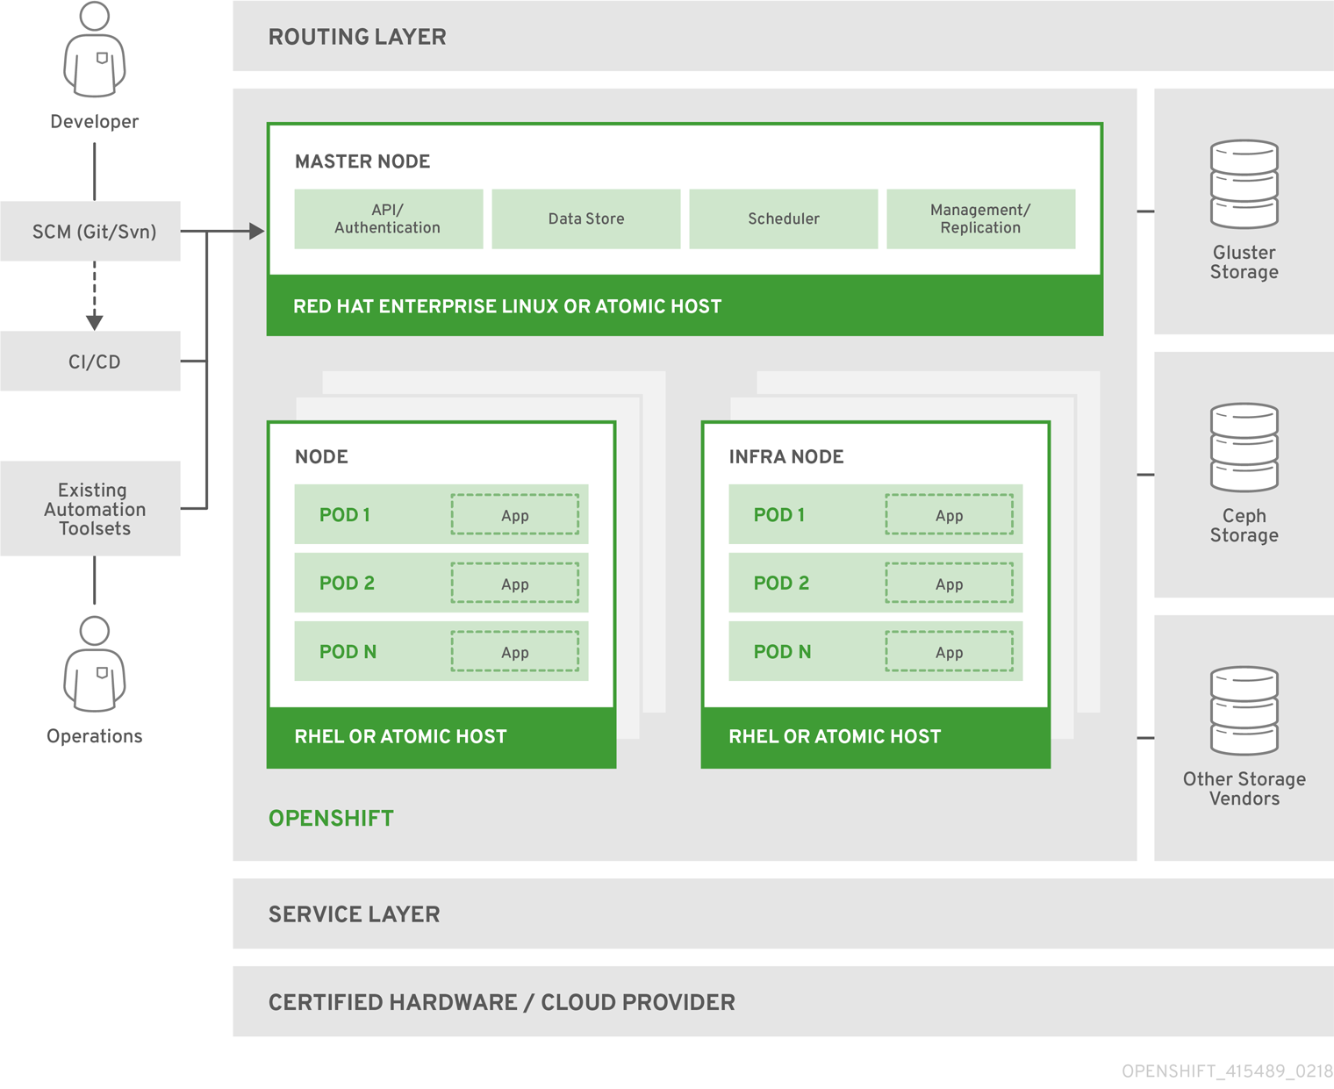
Diagram of Openshift Container Platform infrastructure
Notes:
Instructor notes: Image obtained from Openshift from this link. https://docs.openshift.com/container-platform/3.9/architecture/index.html

Slide 35
Source to Image
Openshift allows you to upload a container image which you have already made using Docker.
Openshift also allows you to upload the source code for supported programming languages to Openshift and Openshift will directly convert it into container images.
Source-to-Image (S2I) is a tool with Openshift which allows a user to easily convert the source code to a Docker container image file.

Slide 36
Preview of Openshift Web Console

Slide 37
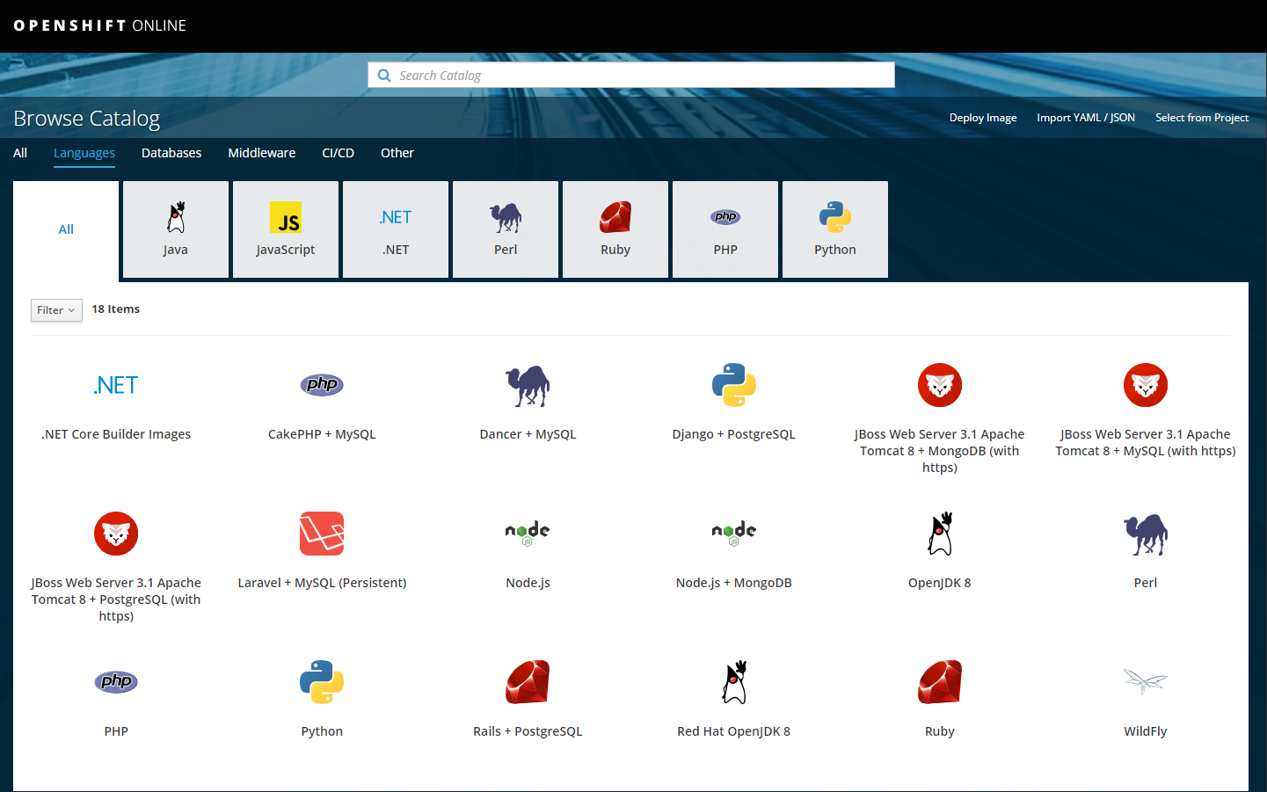
Languages Catalog
A catalog for languages for applying your source code.
Notes:
Instructor notes:

Slide 38
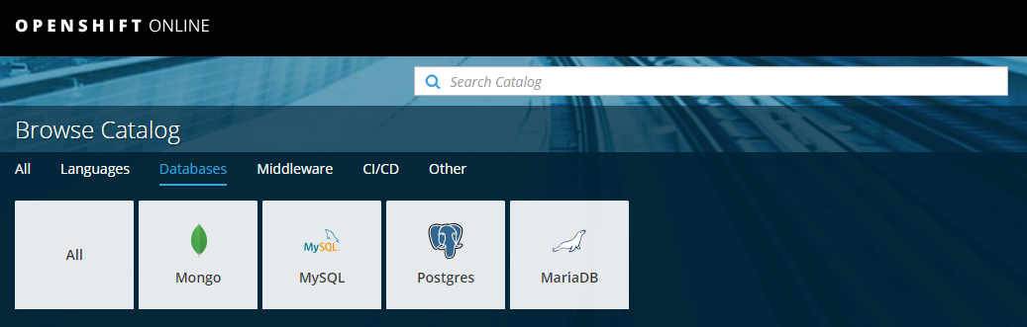
Database Catalog
Notes:
Instructor notes:

Slide 39
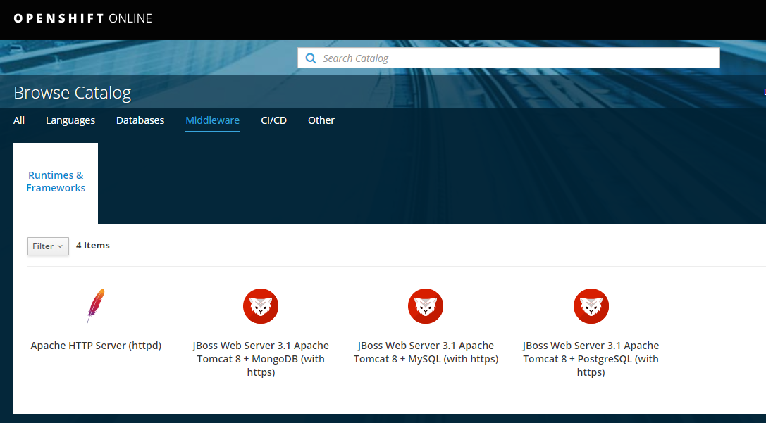
Middleware Catalog
Notes:
Instructor notes:

Slide 40
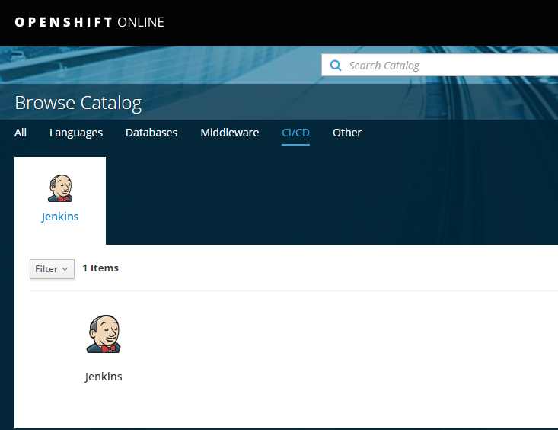
CI/CD Catalog
Notes:
Instructor notes: CI/CD stands for continuous integration and continuous delivery. Jenkins Pipeline is an example of CI/CD. Read more about CI/CD at the AWS website at this link. https://aws.amazon.com/getting-started/projects/set-up-ci-cd-pipeline/

Slide 41
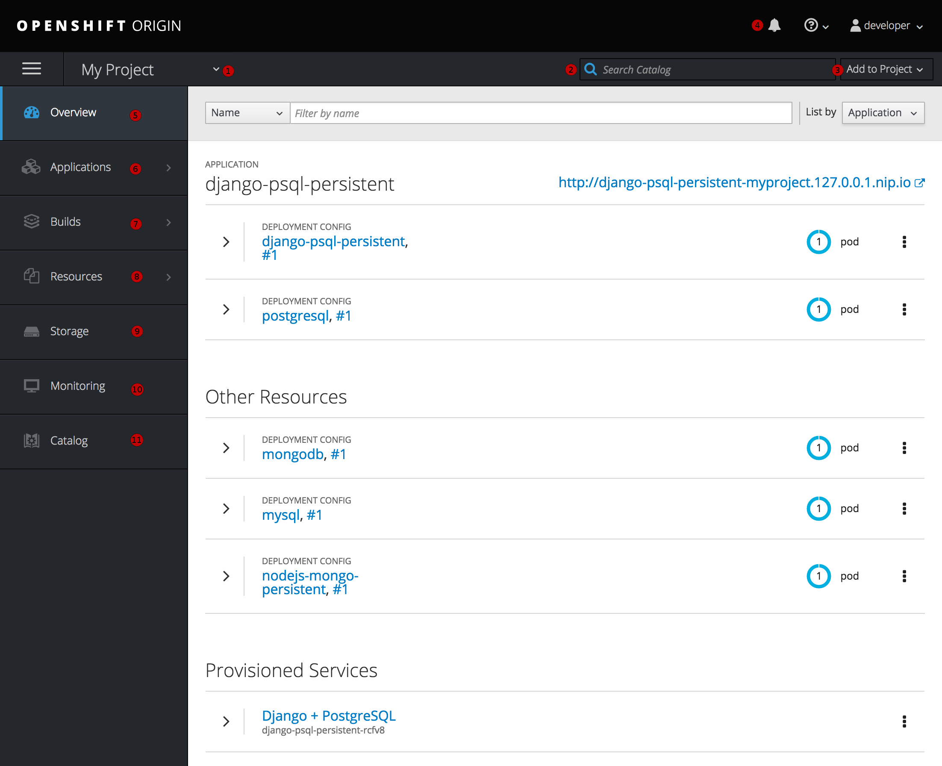
Web Console Project View
Notes:
Instructor notes: Please review the participant notes. Participant notes: Description of numbers on the image above. These allow you to: 1 Project selector - switch between projects 2 Search Bar - search through the catalog 3 Add to Project (top right) - create a new application or service 4 Top Right - view notifications 5 Overview Tab (current view) - see details of current project 6 Applications Tab - review and work with application components 7 Builds Tab - review and take action on project builds and images 8 Resources Tab - review resources and quota 9 Storage Tab - review and manage storage for your project 10 Monitoring Tab - review logs and notifications 11 Catalog Tab - go to the catalog. Image and information obtained from Openshift site at this link. https://docs.openshift.com/online/architecture/infrastructure_components/web_console.html#architecture-infrastructure-components-web-console

Slide 42
Thank You for Completing "An Introduction to Openshift."

Slide 43
End of Presentation
Notes:
Instructor notes: You may now proceed to the Openshift Labs starting with Lab 1.1.

Slide 44
Deploying and Managing Applicattions

Slide 45
Openshift: Deploying and Managing Applications

Slide 46
Openshift: Deploying and Managing Applications
Notes:
Instructor notes: Recommended to cover the "Introduction to Openshift" presentation and Openshift Labs 1.1, 1.2, 1.3 prior to this section. Lab 2.1 gives an introduction to using the CLI interface. Images obtained from Pixabay at these links. https://pixabay.com/en/keyboard-shift-leave-computer-1621104/ https://pixabay.com/en/door-open-wall-open-door-home-1756960/

Slide 47
Meet the Command Line Interface (CLI)

Slide 48

Introduction to Command Line Interface (CLI)
Openshift offers a command line interface to perform any action you need for the deploying of your applications and services.
All of the Openshift related commands are prefaced with "oc".
On Linux/Mac, you will use the terminal to type "oc" commands to interface with Openshift.
On Windows, you will need to open a command prompt "as an administrator" to allow you to run the "oc" commands.
You can check the version of your oc.exe application by typing:
Notes:
Instructor notes: Please review the participant notes. Participant notes: Openshift Lab 1.3 shows you how to install the CLI. Openshift Lab 2.1 helps to introduce some of the basic CLI commands.

Slide 49

Login and Logout using CLI
Many of the "oc" commands require for you to be logged in to your Openshift account by using the oc login command.
To login to CLI access, you must first log in to the Web Console and copy the login link containing your session token information, then paste that information into the command prompt/terminal.
Whenever you are done working with the CLI, you can log out by simply typing:
Notes:
Instructor notes: Please review the participant notes. Participant notes: Openshift Lab 2.1 gives specific instructions on how to login.

Slide 50
Using the Help Command to Get Help from CLI
Using the Command Prompt or Terminal "oc" command you can get help by typing this command: oc help .
The help command gives you a list of possible commands.
If you want more help on a specific command:
then you type the "oc" command and add --help .
If you want help on the new-app command, for example, type: oc new-app --help .
Notes:
Instructor notes: Please review the participant notes. Participant notes: When typing the help command, if you need, you can increase the size of the command prompt or terminal window so you can read it more easily. You can use the --help flag to get help on any of the available commands.

Slide 51
Managing Projects with Openshift CLI
In Openshift, a project allows you to create a separate workspace containing a group of applications and other objects.
To check a list of available projects type oc projects .
To check which project you are on, type oc project .
Switching Projects:
For example, if you have two projects: project1 and project2.
If you are on project1, switch to project2 with this command: oc project project2 .
Creating a new project by typing: oc new-project my-project .
Notes:
Instructor notes: Please review the participant notes. Participant notes: When typing the above commands, replace "my-project" with the name of your project. Objects includes applications, services, resources, stored data, etc. The Openshift Online free starter plan allows you to have only one project a time. If you have any existing projects, the "oc" command will assign yout o one project at a time. All of your commands will automatically affect the project which you are working on. Lab 2.1 reviews the project related commands. Learn more about projects at https://docs.openshift.com/enterprise/3.2/admin_guide/managing_projects.html

Slide 52
Deploying an Application in OpenShift

Slide 53
Options for Sources of Applications
When you want to create and deploy an application, Openshift gives you several possible options of the possible sources of the application.
You can upload the source code directly to Openshift.
You can use an existing template.
You can load an application from an existing container file image.
Notes:
Instructor notes: Please review the participant notes. Participant notes: Read more information about the options for creating an app at this link. https://docs.openshift.com/online/dev_guide/application_lifecycle/new_app.html Read more about templates at this link. https://docs.openshift.com/enterprise/3.0/dev_guide/new_app.html#specifying-a-template

Slide 54

Languages and Resources Available in Openshift
Supported languages:
PHP
Python
Perl
Node.js
Ruby
Java.
Supported Runtimes:
Java
.NET core.
Notes:
Instructor notes: Please review the participant notes. Image retrieved from this link. https://pixabay.com/en/welcome-words-greeting-language-905562/ Participant notes: For more information see these links. https://www.openshift.com/products/features/containers/ https://docs.openshift.com/online/dev_guide/migrating_applications/support_guide.html

Slide 55
Supported Frameworks and Databases
Supported Frameworks:
Jenkins.
Supported Databases:
MySQL
MongoDB
MariaDB
PostgreSQL
Redis.
Notes:
Instructor notes: Please review the participant notes. Participant notes: Read more about databases at this link. https://docs.openshift.com/online/dev_guide/migrating_applications/database_applications.html#migrating-database-applications-supported-databases

Slide 56
Also Supported:
3scale APIcast
Apache HTTP Server (httpd)
Red Hat JBoss A-MQ
Red Hat JBoss BPM Suite Intelligent Process Server
Red Hat JBoss BRMS Decision Server
Red Hat JBoss Data Grid
Red Hat JBoss Data Virtualization
Red Hat JBoss Enterprise Application Platform (EAP)
Red Hat JBoss Fuse Integration Services
Red Hat JBoss Web Server (Tomcat)
Red Hat Single Sign-On (SSO)
Wildfly.
Notes:
Participant notes: Container image files are also supported. For more information see this link.https://www.openshift.com/products/features/containers/ https://docs.openshift.com/online/dev_guide/migrating_applications/support_guide.html

Slide 57
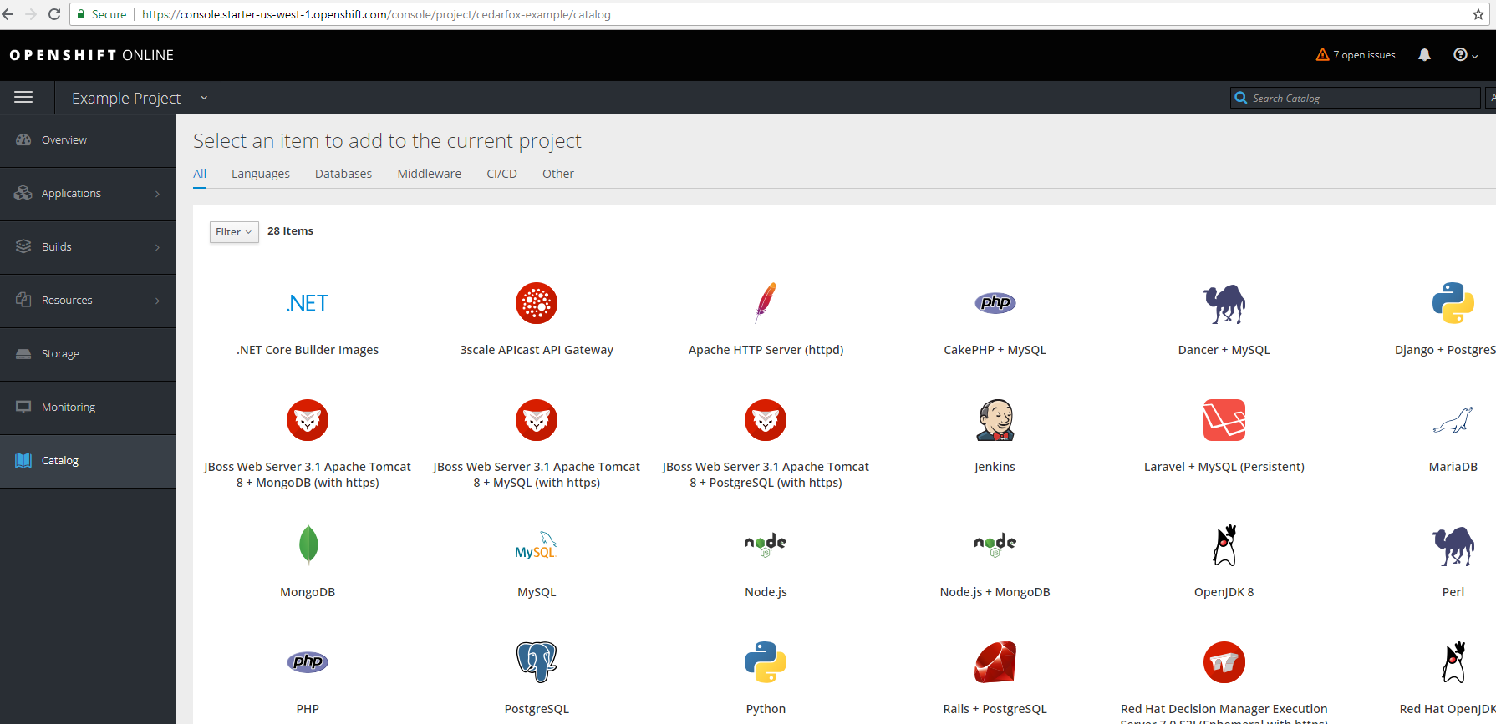
Creating an Application from Source Code with Web Console
Both the Openshift Web Console and the Openshift CLI have tools to automatically build your desired application using Source-to-Image (S2I).
Notes:
Instructor notes: Please review the participant notes. Openshift Lab 1.2 walks through the process of deploying a simple Node.js application from source code in a repository using the Web Console. Openshift Lab 2.1 walks through the process of deploying the same app using the CLI. Participant notes: You can add an application or other object to your Openshift project by selecting the type of item in the catalog on the Openshift Web Console. This will open up a window in which you will specify the configuration data and the repository URL or path to the source code.

Slide 58
Creating an Application from Source Code with CLI
The command line interface (CLI) has a command called "oc new-app" which allows you to create or upload an the source code to your project.
You can specify a local repository for the source of your application with this command.
With oc new-app you can specify a Github repository URL instead. Example.
You can optionally specify a name for all resources associated with the app by using the --name argument. This will apply the name nodejs-example.
Notes:
Instructor notes: Please review the participant notes. Participant notes: If using CLI you must first use the oc login command before you can use the oc new-app command. Instructions in Lab 2.1 The oc new-app command automatically detects the language of the source file. For the oc new-app commands instead of /path/to/your/source/code you will put your actual local path of the source code. Access this link for more information on creating an app. https://docs.openshift.com/online/dev_guide/application_lifecycle/new_app.html

Slide 59

Pipeline Builds
Instead of using a Source-to-Image (S2I) method of building your application, there is the option of using a Jenkins Pipeline to build of your app.
A Jenkins Pipeline is a set of plugins which allows you to automatically update to the server any changes you make to the source code of your applications
Notes:
Instructor notes: Please review the participant notes. Pipeline image obtained from https://pixabay.com/en/right-wrong-button-thumbs-up-1712994/ Participant notes: The Pipeline workflow information needs to be documented in a Jenkinsfile which will be either in the Buildconfig file for your app, or in a separate file which is referenced to in the Buildconfig file. Information of Pipeline builds at this link. https://docs.openshift.com/online/architecture/core_concepts/builds_and_image_streams.html#pipeline-build Information on Jenkins at this link. https://jenkins.io/doc/book/pipeline/

Slide 60
Automatic Detection
When you start to create a new app, Openshift automatically detects the type of application and it also searches for a Jenkinsfile. If it finds it will automatically select the Pipeline Build strategy.
You can manually override this using the CLI with the oc new-app command by using a strategy flag to set it to either a Pipeline build, or S2I build using the following examples.
or
Notes:
Instructor notes: Please review the participant notes. Participant notes: Openshift searches for a Jenkinsfile in the root directory of the source repository. If it finds it, Openshift will automatically select the Pipeline Build Strategy. If not, it will automatically select the Source-to-Image (S2I) strategy. Access this link for more Information https://docs.openshift.com/online/dev_guide/application_lifecycle/new_app.html

Slide 61
Create an Application Using a Template
You can use a template file for your desired type of application, database, or resource to create a new application.
The Web Console has a catalog with different templates in it to start with by clicking on the object in the catalog you want to add.
If using the CLI, you can specify a local template using -f before the template.
Using oc new-app with a local template. Replace the /path/to/nodejs.json with the local path and name of the template file.
Notes:
Instructor notes: Please review the participant notes. Participant notes: Learn more about building an app at this link. https://docs.openshift.com/online/dev_guide/application_lifecycle/new_app.html Learn more about templates at this link. https://docs.openshift.com/online/dev_guide/templates.html#dev-guide-templates

Slide 62
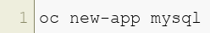
Create an Application Using a Container Image
Creating an application using a container image is a similar process to using the oc new-app command with a template.
Direct the oc new-app command to the container image file instead of the template.
Specify the name or url or path of the container image you want to add. You can specify the Dockerhub name as in these examples.
or
Notes:
Instructor notes: Please review the participant notes. Participant notes: Learn more about building an app at this link. https://docs.openshift.com/online/dev_guide/application_lifecycle/new_app.html

Slide 63
Defining Environmental Variables
To specify values for the parameters in your template file when creating an app, you will use the -p flag like this example
If you want to set environmental variables when loading a container image, use the -e flag, like this example:
After you have imported the source, template, or image, you can define enviromental variables using the "oc set env" command like this example:
Notes:
Instructor notes: Please review the participant notes. Participant notes: Detailed information on setting environmental variables at this link. https://docs.openshift.com/online/dev_guide/environment_variables.html#dev-guide-environment-variables

Slide 64
Checking the Status
You can easily check the status of your applications under the Web Console under the project section.
Using CLI, you can request the status of your applications by simply typing oc status .
Add the -v flag to get more detailed information: oc status -v .
To list services for your app type: oc get services .
For a complete list of everything under your project type: oc get all .
Notes:
Instructor notes: Please review the participant notes. Participant notes: See this link for more information. https://docs.openshift.com/online/getting_started/beyond_the_basics.html#getting-started-beyond-the-basics

Slide 65
Configuring an Application

Slide 66
Configuring Routes
In order for your application to be accessible from a web browser, you will need to configure a route for the application.
How to configure a route:
Get the name of your services by typing: oc get services .
Next, type the "oc expose" command for your service as in this example:
Find the route by typing: oc get routes .
This will give you a web address, copy the web address and paste it in your browser address bar and hit enter to load the page.
Notes:
Instructor notes: Please review the participant notes. Participant notes: Learn more about this process from these links. https://docs.openshift.com/online/getting_started/beyond_the_basics.html#getting-started-beyond-the-basics https://docs.openshift.com/online/dev_guide/routes.html

Slide 67

Automatic Builds
Openshift allows you to automatically rebuild the application on the server:
By a Jenkins Pipeline
By using a webhook.
Notes:
Instructor notes: Image obtained from https://pixabay.com/en/tools-do-it-yourself-hammer-498202/

Slide 68
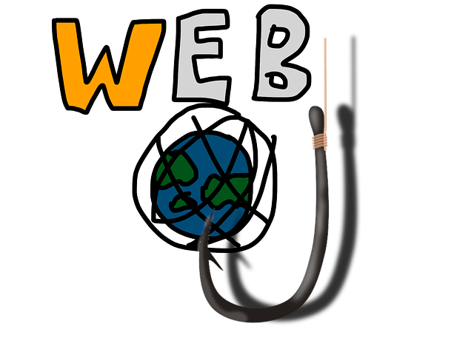
Webhooks
Webhooks are a type of trigger which cause your application on Openshift to be automatically rebuilt under certain specified conditions, such as using "git push" to update the repository of your application.
Notes:
Instructor notes: Please review the participant notes. Images obtained from https://pixabay.com/en/hook-fish-fisherman-fishing-hobby-159682/ https://pixabay.com/en/world-wide-web-www-lettering-world-341418/ Participant notes: The simplest way to use a webhook involves copying the webhook link from the Openshift web console, and pasting it on your Github website account. Once this is successfully set up, changes to the application on the server will be automatically updated when you push your changes to the Github repository. Openshift Lab 1.2 Step 4 describes the process of applying the webhook to your Github account. It is also possible to get the webhook URL and secret using the command line interface. You can also use other repositories besides Github if you prefer.

Slide 69
Git Push
You can make changes to your application on your local computer and then use your "Git Bash" command line or terminal to "git push" to update your changes on the repository.
If you have automatic builds configured, this will automatically update the applicaiton on the server.
Notes:
Instructor Notes:

Slide 70

BuildConfig files
A BuildConfig is a file which is created automatically when you create a new app on the Web Console or using the "oc new-app" command.
A BuildConfig contains configuration settings for creating a new build and contains information about triggers for rebuilding the app.
Notes:
Instructor notes: Image obtained from https://pixabay.com/en/cog-wheels-gear-wheel-machine-2125183/

Slide 71
About BuildConfig files
The following types of triggers can be used to rebuild the app.
A Github or generic webhook.
Image change trigger
Configuration change triggers
A Buildconfig file is generally in .yaml or .json formats and can be edited with the CLI and a text editor.
A Buildconfig file can also be edited directly on the Web Console in the Builds section.
Notes:
Instructor notes: Please review the participant notes. Participant notes: An image change trigger will automatically rebuild the app when the a new image is available. A Configuration change trigger will automatically rebuild the app when a configuration file, such as BuildConfig file is updated. Openshift Lab 2.2 will walk through the process of editing BuildConfig and DeploymentConfig files. Read more about builds and buildconfig files at https://docs.openshift.com/online/dev_guide/builds/index.html https://blog.openshift.com/working-openshift-configurations/

Slide 72
DeploymentConfig files
A DeploymentConfig file is automatically created when you create a new application using the Web Console or the "oc new-app" command.
The DeploymentConfig file specifies details about the
Pods
Replication Controllers
Triggers
Health checks
The DeploymentConfig file can be edited directly in the Web Console under Applications or through the CLI and a text editor.
Notes:
Instructor notes: Please review the participant notes. Participant notes: Openshift Lab 2.2 will walk through the process of editing BuildConfig and DeploymentConfig files. More information about DeploymentConfig files available at https://docs.openshift.com/online/dev_guide/deployments/how_deployments_work.html

Slide 73
Persistent Volume and Persistent Volume Claims
Persistent Volumes (PV) are available storage resources on the cluster.
Persistent Volume Claims (PVC) request a specific amount of data to be used as storage and once it is setup, it safeguards that PV storage space to be only used for the applications which have requested it.
If your application requires stored data, such as a database, then the PVC will provision storage space for the application.
A PersistentVolumeClaim file is a configuration file with details about the configuration of the PVC. It can be edited using CLI and a text editor.
Notes:
Instructor notes: Please review the participant notes. Participant notes: Openshift Lab 2.3 will walk through the process of creating a PVC and editing the configuration file.

Slide 74

Secrets
A secret file is an object which contains sensitive data such as a user id and password for services.
Notes:
Instructor notes: Image obtained from this link. https://pixabay.com/en/treasure-chest-chain-castle-brown-3005312/

Slide 75
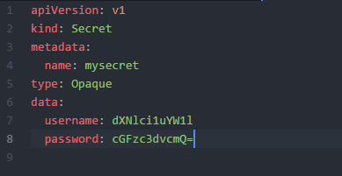
Creating a Secret
You can generate a secret by creating a yaml text file on your local computer in the secret format like the one below.
If you named the file secret.yaml, you can use command line to create a secret file: oc create -f secret.yaml .
Notes:
Instructor notes: Please review the participant notes. Participant notes: Once you have created a secret file, the pods can refer to that secret in the pod files. You can also easily create a secret file through the Web Console under REsources / Secrets. For more information on secrets, visit https://docs.openshift.com/online/dev_guide/secrets.html

Slide 76

Health Checks
Health Checks are a way to ensure that the applications are operating correctly.
There are two types of health checks:
A readiness probe checks if the application is able to handle requests.
The application needs a route for the readiness probe to check it.
If the readiness probe fails, the IP address to the services is removed.
A liveness probe checks if a container is still running.
If the liveness probe fails, it will automatically kill the container.
Notes:
Instructor notes: Image obtained from https://pixabay.com/en/investigation-stethoscope-to-listen-2458540/

Slide 77
Configuring Health Checks
Health checks can be configured under the Web Console under deployment, or in CLI. For example:
Set initial delay for health checks using the "oc set probe" command as in this example:
Notes:
Instructor notes: Please review the participant notes. Participants can now complete the Openshift labs 2.1 and 2.2. Participant notes: You can also add or edit health checks by editing the DeploymentConfig file. Read the following for more information on health checks. https://docs.openshift.com/online/dev_guide/application_health.html Read the following link for more information on "oc set probe": https://www.mankier.com/1/oc-set-probe

Slide 78
Thank you for completing "Openshift Part 2"

Slide 79
End of Presentation
You may now proceed to Openshift Lab 2.1.

Slide 80
Complex Deployments

Slide 81
Openshift: Creating Complex Deployments

Slide 82
Openshift: Creating Complex Deployments
Notes:
Instructor notes: It is recommended for participants to complete the Openshift_Intro and Openshift_Part_2 presentations and the Openshift Labs 1.1 - 2.3 prior starting this module. Images obtained from Pixabay at these links. https://pixabay.com/en/keyboard-shift-leave-computer-1621104/ https://pixabay.com/en/door-open-wall-open-door-home-1756960/

Slide 83
Scaling an Application

Slide 84

Why Scale an Application?
For a web service, it is necessary to provide multiple copies of the application components so more than one user can use the application simultaneously.
Scaling an application means to increase or decrease the replicas of the pods and resources based on the needed number.
Openshift has features built-in which help you to automatically scale the application.
Notes:
Instructor notes: Please review the participant notes. Image obtained from the following link. https://pixabay.com/en/horizontal-old-weights-old-scale-930716/ Participant notes: We will now review some of the components of the architecture used in Openshift.

Slide 85

Pods and Replicas
A pod is a Kubernetes subunit that consists of:
one or more containers
shared network and storage
a single IP address and port space
specifications of how to run the containers.
A replica is multiple instances of the same type of pod.
Notes:
Instructor notes: Information obtained from the following. Duncan, J., Osborne, J. (2018). Openshift In Action. Manning Publications: Shelter Island, NY. www.allitebooks.com https://kubernetes.io/docs/concepts/workloads/pods/pod/ Image obtained from the following link. https://pixabay.com/en/twins-two-peas-in-a-pod-pea-pod-1147613/

Slide 86
Services
Although pods can be either running or not running, a service is always on and available.
A service is a representation of all the replicas of a particular application or function.
A service defines the operation of the pods and sets policies of when to access the pods.
Each service is accessed by a single IP address.
Notes:
Instructor notes: Information obtained from the following. Duncan, J., Osborne, J. (2018). Openshift In Action. Manning Publications: Shelter Island, NY. www.allitebooks.com https://docs.openshift.com/container-platform/3.9/architecture/core_concepts/pods_and_services.html#architecture-core-concepts-pods-and-services https://kubernetes.io/docs/concepts/services-networking/service/#defining-a-service

Slide 87
Routes and Load Balancers
A route provides an accessible web address to a particular service, so that it can be reached through the network or internet.
Openshift has a software load balancer that is built-in to the routing layer of of the Openshift architecture. It is the load balancer that maps out, provides, and controls the routes to the services.
The load balancer is a key component which also helps to automatically scale your applications.
Notes:
Instructor notes: Information obtained from the following. Duncan, J., Osborne, J. (2018). Openshift In Action. Manning Publications: Shelter Island, NY. www.allitebooks.com

Slide 88
Replication Controllers
A replication controller is a special type of pod which has the function of scaling the application by creating enough replicas of the needed application.
A replication controller will automatically increase or control the number of replicas of the application based on the need.
DeploymentConfig files contain the details of the replication controllers and number of replicas for the deployment.
You can check for a list of replication controllers using the command below.
Notes:
Instructor notes: Please review the participant notes. Information obtained from the following. Duncan, J., Osborne, J. (2018). Openshift In Action. Manning Publications: Shelter Island, NY. www.allitebooks.com Participant notes: You can also abbreviate "replicationcontrollers" with "rc".

Slide 89
Stateless and Stateful Applications
An application that is "stateless" is one that does not need to store data or access stored data other than the application itself.
A "stateful" application stores an accesses data as part of its operations. Any application which utilizes a database would be a stateful application.
If you are deploying only stateless applications, much of the scaling process of the application is automatic.
If you deploy stateful applications then you will need to also provide persistent storage which is able to scale up and down with the usage of the application.
Notes:
Instructor notes: Information obtained from the following. Duncan, J., Osborne, J. (2018). Openshift In Action. Manning Publications: Shelter Island, NY. www.allitebooks.com

Slide 90
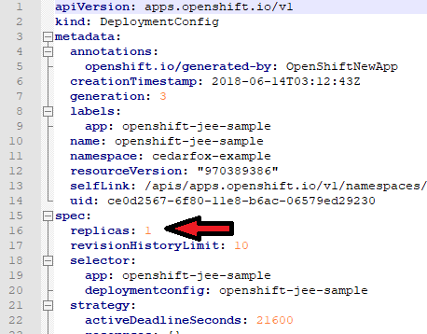
Scaling an Application by Editing the Deployment Configuration
The deployment configuration contains details of the replication controllers. You can manually scale an application by simply editing the deployment configuration file.
Notes:
Instructor notes: Please review the participant notes. Information obtained from the following. Duncan, J., Osborne, J. (2018). Openshift In Action. Manning Publications: Shelter Island, NY. www.allitebooks.com Participant notes: In the example pictured here, you would change the number of replicas by changing the number "1" on line 16 to the desired number and save and update the DeploymentConfig file.

Slide 91
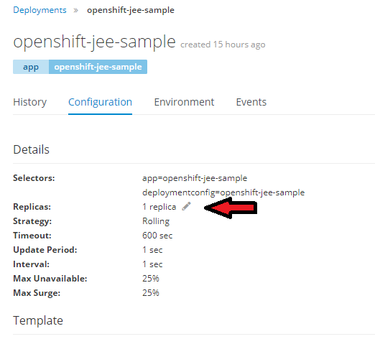
Changing Number of Replicas with the Web Console
You can change the number of replicas using the web console.
Notes:
Instructor notes: Please review the participant notes. Information obtained from the following. Duncan, J., Osborne, J. (2018). Openshift In Action. Manning Publications: Shelter Island, NY. www.allitebooks.com Participant notes: When you are in the Web Console managing your project, you can change the number of replicas: Click on Applications, then click on Deployments. Click on the name of the deployment you want to change. Click the configuration tab. Then you can click the pencil next to the "1 replica" and put in the number of replicas you would like. Keep in mind that the actual number of replicas which will be running depend on the amount of the server resources available and also on the need.

Slide 92
Changing Number of Replicas
How to change the number of replicas:
You can scale an application up and down manually by simply changing the number of replicas in the DeploymentConfig file.
You can also scale an application by changing the number of replicas the deployment configuration settings section on the web console.
You can use the oc scale command in the CLI as in this example.
Notes:
Instructor notes: Please review the participant notes. Information obtained from the following. Duncan, J., Osborne, J. (2018). Openshift In Action. Manning Publications: Shelter Island, NY. www.allitebooks.com Participant notes: Keep in mind that the actual number of replicas which will be running depend on the amount of the server resources available and also on the need.

Slide 93
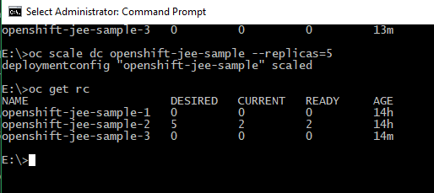
How to Get Information about the Replication Controllers using the CLI
Using CLI, you can refer to the replication controllers by "rc."
Type the command: oc get rc to see the names of the replication controllers and the number of replicas running.
Notes:
Instructor notes: Please review the participant notes. Information obtained from the following. Duncan, J., Osborne, J. (2018). Openshift In Action. Manning Publications: Shelter Island, NY. www.allitebooks.com Participant notes: You can also view or save a copy of the replication controller configuration files in the same way you can with other configuration files using the "oc edit rc" and "oc get rc" commands.

Slide 94
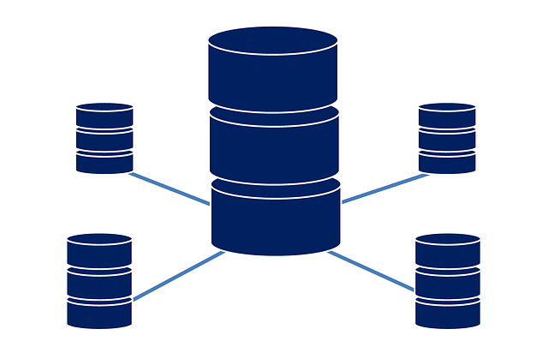
Stateful Sets
With Openshift, you can also scale stateful applications, such as applications which utlilize a database.
Openshift refers to the stateful application pods as a "stateful set."
Notes:
Instructor notes: Please review the participant notes. Information obtained from the following. Duncan, J., Osborne, J. (2018). Openshift In Action. Pages 162-164. Manning Publications: Shelter Island, NY. www.allitebooks.com Image obtained from the following. https://pixabay.com/en/database-data-technology-1928236/ Participant notes: The simplest way to install a database with a stateful set is to create it using a template designed for a stateful set database. You can use the "oc scale" command to scale the database, but you need to specify "statefulsets" in the command like in this example. "oc scale statefulsets mongodb --replicas=5" If you create a stateful set of a Mongdb database, it will create multiple replicas of the Mongodb pods.

Slide 95
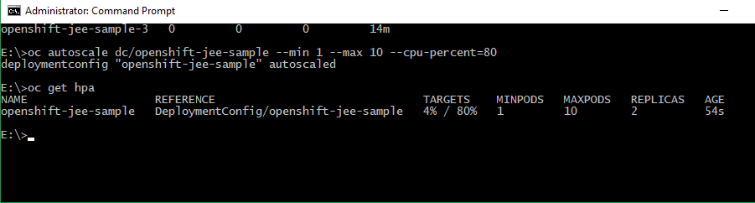
Autoscaling
Openshift allows you to automatically scale the application by specifying the:
Minimum number of pods
Maximum number of pods
Maximum percentage of server CPU usage that you would like to use.
You can set easily set up autoscaling in the deployment section of the web console.
You can also use the oc autoscale command like in the following example.
Notes:
Instructor notes: Please review the participant notes. Information obtained from the following. https://docs.openshift.com/online/dev_guide/pod_autoscaling.html Participant notes: Use the "oc get hpa" command to check the status of the autoscaling function. HPA stands for "horizontal pod autoscaler."

Slide 96

Clustering an Application
A cluster is defined as a group of servers connected together which share their resources to act as one functional unit.
Your cluster in Openshift would be the largest functional unit consisting of a Master node, other nodes, storage, as well as routing layer.
Clustering is when a group of applications or servers need to interact with a single database. When there are many users and many replicas of a pod, this needs to be done efficiently.
Notes:
Instructor notes: Please review the participant notes. Information obtained from the following. Duncan, J., Osborne, J. (2018). Openshift In Action. Pages 147-167. Manning Publications: Shelter Island, NY. www.allitebooks.com https://www.techopedia.com/definition/17/clustering-databases Image obtained from the following. https://pixabay.com/en/grapes-bunch-fruit-viticulture-2151467/ Participant notes: Openshift in Action is a book which is an excellent resource for a more detailed explanation on clustering an application. (Please refer to Openshift in Action, chapter 8, pages 147-167>) The book provides an explanation of how to use clustering in an application. The chapter also gives the link to a template of a Wildfly application which can be used as an example of application clustering. Below is the URL referenced to as a template. https://github.com/elephantscale/openshift-cluster-example Information obtained from the following book. Duncan, J., Osborne, J. (2018). Openshift In Action. Pages 147-167. Manning Publications: Shelter Island, NY. www.allitebooks.com

Slide 97
Configuring Pods
In Openshift, the pods have object definition files that can be edited and modified to configure the functioning of the pod.
The pod object definition file contains various settings and specifications including:
Network Information such as the IP address and ports
Resources allocated to the pod
Names of containers
PVC and volumes allocated to the pod
Replication controller specifics
Name of the pod scheduler policy
Pod restart policy.
Notes:
Instructor notes: Please view the participant notes. Information obtained from the following. https://docs.openshift.com/online/architecture/core_concepts/pods_and_services.html Participant notes: Openshift Lab 2.3 describes how to view and edit the pod object definition files.

Slide 98
Pod Scheduling
Policies for the operation of pods are specified in a default pod schedule file which is automatically deployed.
Each pod object definition file will refer to the name of the scheduler being used to determine these policies.
You can create custom .yaml file which has different policies and priorities for the operation of the pods. This is called a custom scheduler.
Notes:
Instructor notes: Please view the participant notes. Information obtained from the following. https://docs.openshift.com/container-platform/3.9/admin_guide/scheduling/scheduler.html Participant notes: Openshift Lab 2.3 describes how to view and edit the pod object definition files. Openshift online documentation has the text for the default scheduler on the website at the link below. The site explains each parameter in the file. You can copy the default configuration and paste it in a new yaml file with a text editor. Please see the information at this link. https://docs.openshift.com/container-platform/3.9/admin_guide/scheduling/scheduler.html

Slide 99
Pod Restart Policy
The pod object definition file specifies the pod restart policy. By simply editing the pod object definition file, you can configure each pod to restart based on three options.
Always - continuously tries to restart a container in a pod which has successfully exited.
On Failure - tries to restart a container in a pod which had failed to start for up to 5 minutes.
Never - does not try to restart a container on a pod whether it exited successfully or failed to start.
Notes:
Instructor notes: Information obtained from the following link. https://docs.openshift.com/online/architecture/core_concepts/pods_and_services.html

Slide 100
Routes in OpenShift
Openshift has a default, built in router which automatically handles the routing requests with a few basic commands or with the web console.
Use the oc expose command to assign an accessible route to a service.
The oc expose command lets you add arguments to specify:
A custom address as a route
Ports
Protocol
and more.
The oc get routes command will list the routes already assigned.
Notes:
Instructor notes: Please view the participant notes. Information obtained from the following. https://docs.openshift.com/online/dev_guide/routes.html Participant notes: The web console allows you to create and edit routes under the Applications, Routes tab. For help on the "oc expose" command, type "oc expose --help" into the CLI. Custom routes are not allowed in Openshift Online starter plan, but they are allowed in the Openshift Online Pro plan.

Slide 101
Routers in Openshift
Routers are a key component of Openshift Container Platform for managing traffic into the cluster.
Openshift Container Platform will automatically install the default HAProxy router, if you use the quick installation option.
You can save a copy of the default router configuration file by typing the following command: oc adm router --dry-run -o yaml > router.yaml .
After editing the configuration settings in the router.yaml file, you can then create a router by typing the command: oc create -f router.yaml .
Notes:
Instructor notes: Please view the participant notes. Information obtained from the following. https://docs.openshift.com/container-platform/3.6/install_config/router/index.html#install-config-router-overview https://docs.openshift.com/container-platform/3.6/install_config/router/default_haproxy_router.html#install-config-router-default-haproxy Participant notes: You will need a trial account with Openshift Container Platform configure routers properly. You will get some errors when you try to install a router with Openshift Online. You can still practice editing the router configuration files with Openshift Online. Once the router is installed, it has its own deployment configuration file which you view or edit like any other configuration file in Openshift. The router configuration file specifies the number of replicas of the router. You can change the number of replicas simply by editing the number in the file and replacing the updated file on the server.

Slide 102
Thank you for completing "Openshift Part 3"

Slide 103
End of Presentation
You may now proceed to Openshift Lab 3.1.

Slide 104
Troubleshooting Applications

Slide 105
Openshift: Troubleshooting Applications

Slide 106
Openshift: Troubleshooting Applications
Notes:
Instructor notes: Images obtained from Pixabay at these links. https://pixabay.com/en/keyboard-shift-leave-computer-1621104/ https://pixabay.com/en/door-open-wall-open-door-home-1756960/

Slide 107
Resources Available for Support

Slide 108

Openshift Technical Support Available offered by Red Hat®
Openshift Online Starter plan: community support only.
Openshift Online Pro plan: basic technical support.
Openshift Dedicated plan: premium technical support.
Openshift Container Platform: either basic or premium technical support.
Red Hat® also offers training for Openshift Container Platform customers.
Notes:
Instructor notes: Information obtained from the following. https://www.openshift.com/products/pricing/ Image obtained from the following link. https://pixabay.com/en/customer-service-call-center-support-2288639/

Slide 109
Cluster Administration
Red Hat® completly manages cluster administration in the Openshift Online and Openshift Dedicated plans.
The customer manages cluster administration with Openshift Container Platform.
Notes:
Instructor notes: Information obtained from the following. https://www.openshift.com/products/pricing/ Image obtained from the following. https://pixabay.com/en/grapes-bunch-fruit-viticulture-2151467/

Slide 110

Networking Support
Openshift Online plans: networking is managed by Red Hat®.
Openshift Dedicated plans: networking is managed by Red Hat® but is customizable.
Openshift Container Platform plans: networking is customizable and controlled by the customer.
Notes:
Instructor notes: Information obtained from the following. https://www.openshift.com/products/pricing/ Image obtained from the following. https://pixabay.com/en/network-social-abstract-3139214/

Slide 111
Openshift has Extensive Documentation Available Online
Openshift has some tutorials to get you started including the "Basic Walkthrough," and the "Beyond the Basics" tutorials.
You can easily search the online documentation on the Openshift website.
Openshift has a blog on its website where various authors write tutorials, access to example applications, and other helpful information.
Notes:
Instructor notes: Please review the participant notes. Participant notes: The link to the tutorials is below. https://docs.openshift.com/online/getting_started/index.html The Openshift online documentation is at this link. https://docs.openshift.com/index.html The Openshift blog is available at this link. https://blog.openshift.com/

Slide 112
Openshift Documentation has Many Helpful Tutorials and Links
The "Beyond the Basics" tutorial contains many helpful links including the following:
Tutorials and templates for applications using: Ruby, Python, Node.js, PHP, PERL, and Java.
Links to the Github repository for images and templates.
Other tutorials include:
Quickstart templates with repository links.
Ruby on Rails
Setting up a nexus mirror
Openshift Pipeline builds
Binary builds.
Notes:
Instructor notes: Please review the participant notes. Participant notes: The link to the "Beyond the Basics" tutorial is below. https://docs.openshift.com/online/getting_started/beyond_the_basics.html The links to other tutorials are listed here. https://docs.openshift.com/online/dev_guide/dev_tutorials/index.html

Slide 113
Openshift CLI Reference Documentation
Openshift has a helpful CLI reference guide included in the documentation.
The oc --help command and specific help for each command is built-in to the oc.exe command.
Notes:
Instructor notes: Please review the participant notes. Participant notes: The CLI online reference guide is available at the following link. https://docs.openshift.com/online/cli_reference/index.html

Slide 114

Openshift Github Repository
A larger catalog of templates, container images, example applications, and documentation is available at the Github repository at the following link.
https://github.com/openshift
Notes:
Instructor notes: Image obtained from the following link. https://pixabay.com/en/github-logo-favicon-mascot-button-154769/

Slide 115
Openshift in Action
"Openshift in Action" is a very helpful textbook guide through Openshift.
It is a highly recommended resource and is available in ebook format.
There is a Github repository with example applications from the book at this website:
https://github.com/openshiftinaction
Notes:
Instructor notes: Please review the participant notes. Participant notes: Citation for "Openshift In Action" below. Duncan, J., Osborne, J. (2018). Openshift In Action. Manning Publications: Shelter Island, NY. www.allitebooks.com

Slide 116
Debugging an Application with Openshift

Slide 117


Debugging using the Openshift CLI
The oc debug command opens up a debug pod with a command shell where you can manually debug an existing pod or deployment using shell commands.
An example debug command to debug the deployment wildfly-app is below.
At the shell prompt, type help for a list of commands.
To exit the shell, simply type exit .
Notes:
Instructor notes: Please review the participant notes. Information obtained from: https://docs.openshift.com/online/cli_reference/basic_cli_operations.html#debug Participant notes: You would need to be familiar with using shell commands to be able to manually debug this way.

Slide 118

Open a Command Shell into a Container
The oc rsh command is similar to the oc debug command; it opens up a command shell into a container.
First type oc get pods .
Choose the name of a pod listed, for example: wildfly-app-2-cctcc .
To open the command shell, type the command oc rsh wildfly-app-2-cctcc .
Notes:
Instructor notes: Please review the participant notes. Information obtained from: https://docs.openshift.com/online/cli_reference/basic_cli_operations.html#debug Image obtained from the following. https://pixabay.com/en/sea-shell-clam-ocean-sea-shells-1162744/ Participant notes: At the shell prompt, type "help" for a list of commands. To exit the shell, simply type "exit".

Slide 119
Debug using Eclipse
You can also debug using Eclipse or any other software that supports remote debugging.
In order to debug, you will need to open the debug port using this command below.
Get the name of your pods by typing oc get pods .
Use the active-pod name in the example below to forward the port to your debugger.
You can then access the java application remotely at port 8787.
Notes:
Instructor notes: Please review the participant notes. Participant notes: A tutorial regarding debugging with Eclipse and the information obtained from the above example is available at the link below. Please review the link for more information and steps how to debug using this method. https://blog.openshift.com/debugging-java-applications-on-openshift-kubernetes/

Slide 120

Viewing Logs in OpenShift
You can easily view logs of various types in the CLI using the oc logs command.
With oc logs , you can view the log data of:
pods
builds
build configurations
deployment configurations
See the following example. Replace "my-pod-name" with the actual name of the pod.
Notes:
Instructor notes: Please review the participant notes. Participant notes: The default setting of "oc logs" will print historical logs up to present on the screen. If you add the ""-f" argument, it will stream the log onto the console adding real time log data. But then you cannot use that window to execute other commands. Please see this link for more information on the "oc debug" and "oc logs" commands. https://docs.openshift.com/online/cli_reference/basic_cli_operations.html#debug

Slide 121
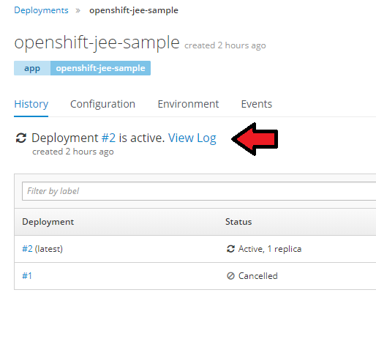
Viewing Logs using the Web Console
You can also view the historical and streaming logs using the Openshift Web Console.
Notes:
Instructor notes: Please review the participant notes. Participant notes: To view the deployment configuration log from the web console, click Applications then Deployments and select the deployment application name. Then click on the "View log" link.

Slide 122
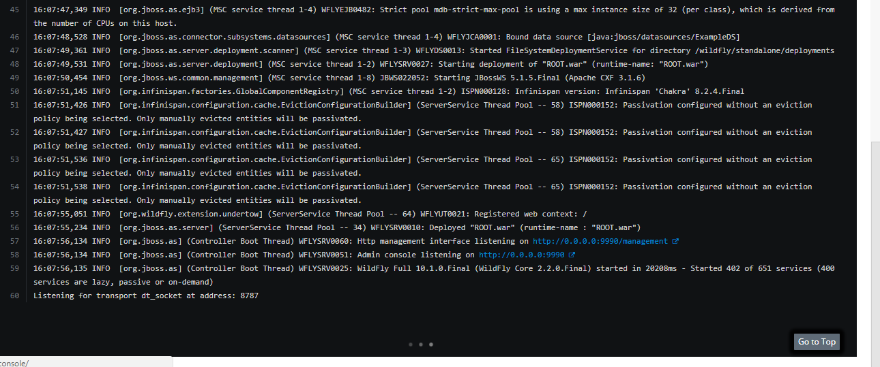
A View of a Log from the Web Console
This is a view of a deployment configuration log.
Notes:
Instructor notes:

Slide 123
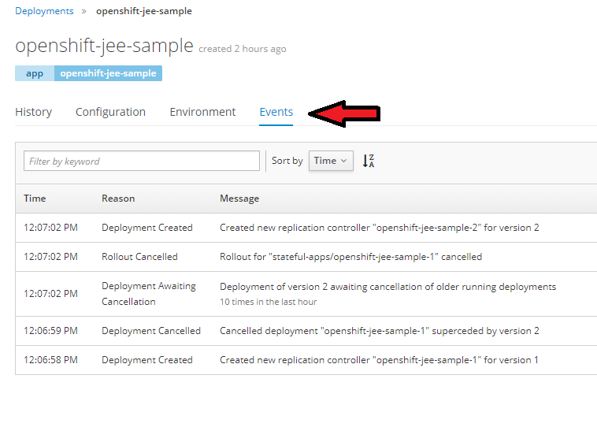
Viewing Events
"Events" refers to those events which affect API objects on your Openshift Cluster.
This is a list of events for a deployment of an application.
Notes:
Instructor notes: Please review the participant notes. Participant notes: You can easily view events from the Web Console by clicking the name of a deployment, build, pod, or other resource and clicking on the "Event" tab. You can request events in the CLI by typing the following command and replace my-project with the actual name of your project. "oc get events -n my-project" View this link for more information on events. https://docs.openshift.com/online/dev_guide/events.html

Slide 124
Thank you for completing "Openshift Part 4."

Slide 125
End of Presentation
Participants may now proceed to Openshift Lab 4.1.

